Slide 1
DSC Registration & Bill Signing User Manual

Slide 2
Prerequisite
1
emSigner
2
SafeNet Authentication Client
3
Internet Explorer Browser
4
Port 8080 on Local Computer

Slide 3
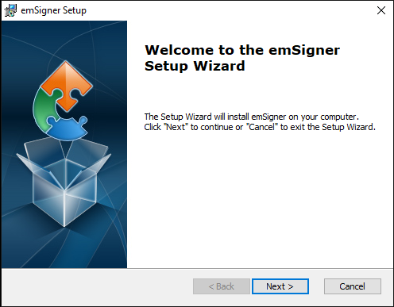
emSigner Installation
Double Click emSigner.exe
Click “Next” to start Installation.

Slide 4
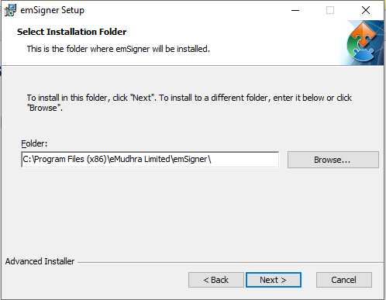
emSigner Installation
3. Change Installation location(if required) then Click on “Next” button.

Slide 5
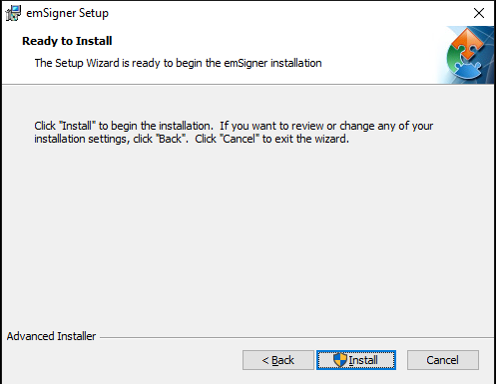
emSigner Installation
4. Click “Install” to begin Installation.

Slide 6
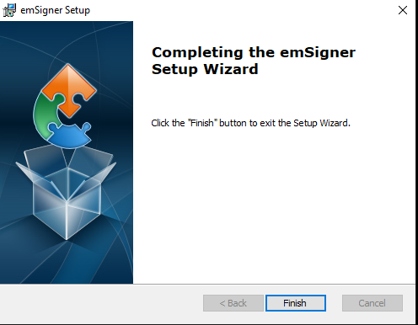
emSigner Installation
5. Click on “Finish” button to completed installation.

Slide 7
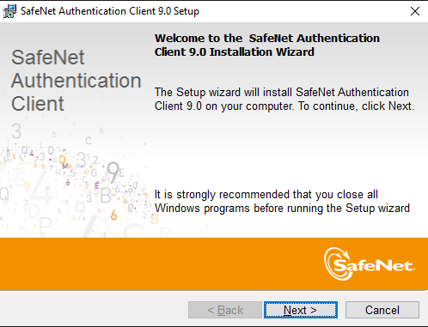
SafeNet Authentication Client Installation
Double Click SafeNetAuthenticationClient-x64-9.0.exe
Click “Next” to start Installation.

Slide 8
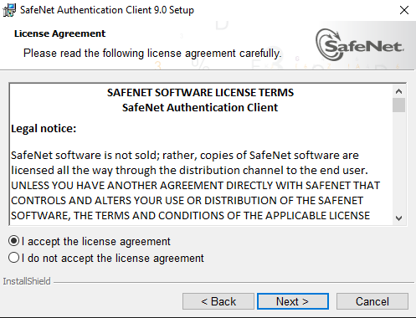
SafeNet Authentication Client Installation
3. Select “I accept the license agreement” and Click “Next” button

Slide 9
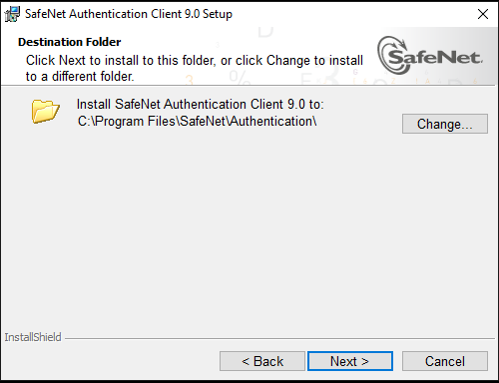
SafeNet Authentication Client Installation
4. Change Installation location(if required) then Click on “Next” button.

Slide 10
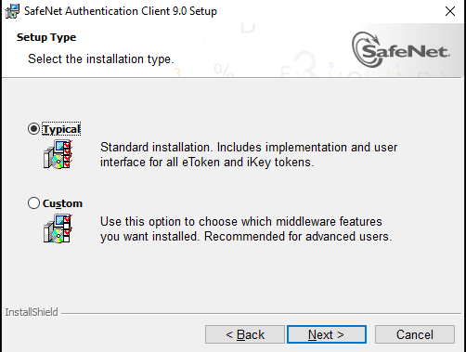
SafeNet Authentication Client Installation
5. Select Setup Type as “Typical” and Click “Next” button.

Slide 11
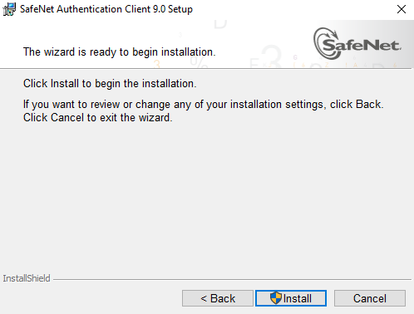
SafeNet Authentication Client Installation
6. Click “Install” to begin Installation.

Slide 12
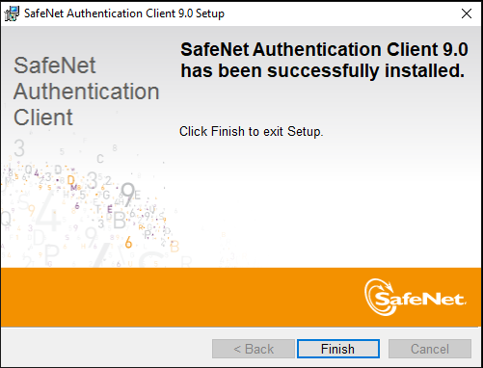
SafeNet Authentication Client Installation
7. Click on “Finish” button to completed installation.

Slide 13
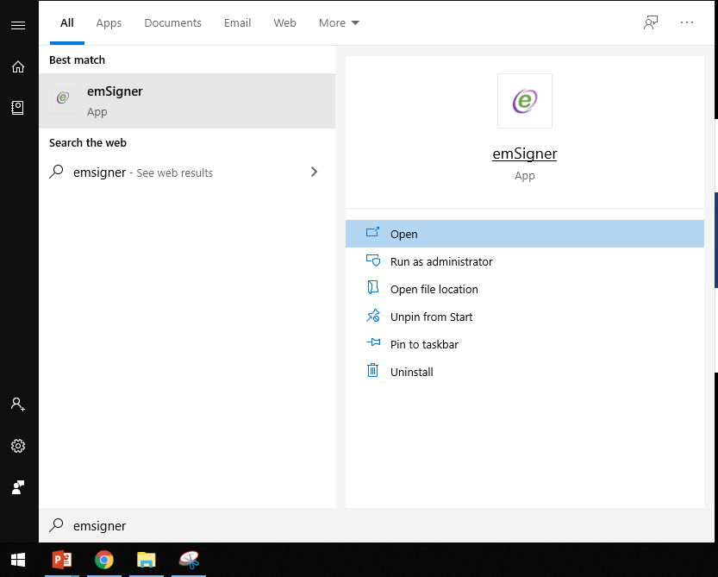
Starting emSigner Service
Click start ➔ type emSigner ➔ Open

Slide 14
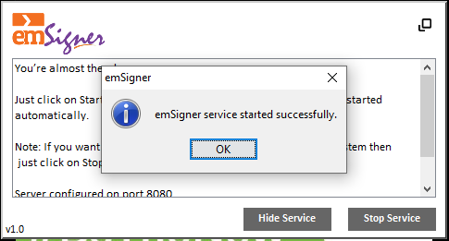
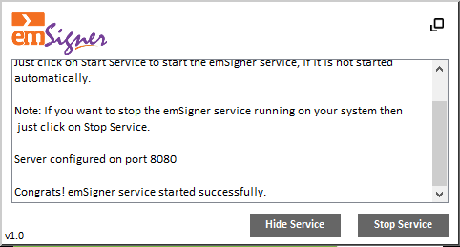
Starting emSigner Service
Make sure emSigner is running on port “8080”

Slide 15
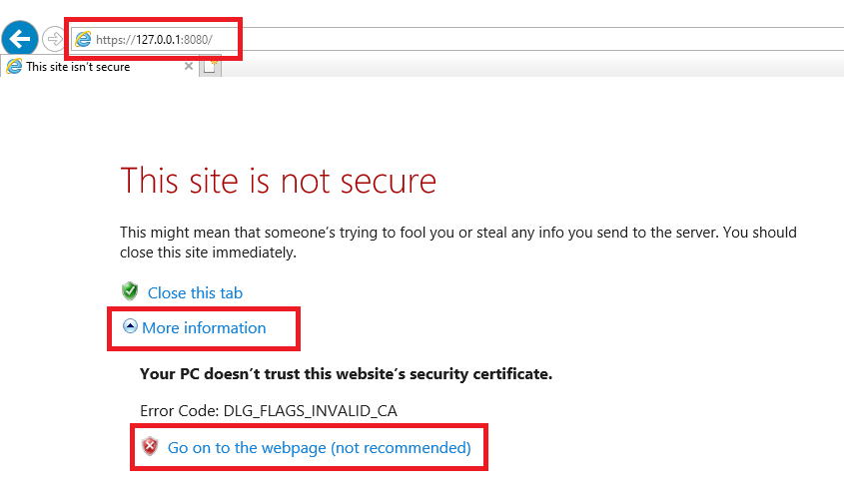
Starting emSigner Service
Open Browser
Goto https://127.0.0.1:8080/
Click “More Information” and “Go on to the webpage (not recommended)”

Slide 16
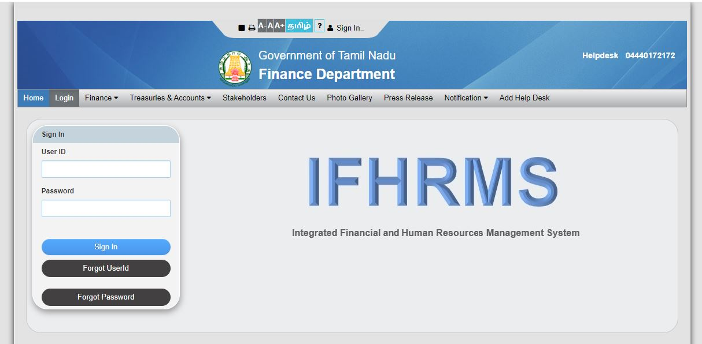
Registering DSC User in IFHRMS Application
1. Login into IFHRMS Application.

Slide 17
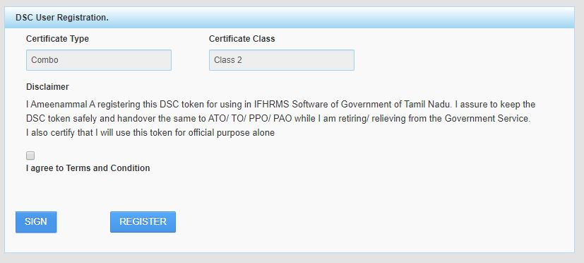
Registering DSC User in IFHRMS Application
2. Click “DSC Registration” tile.

Slide 18
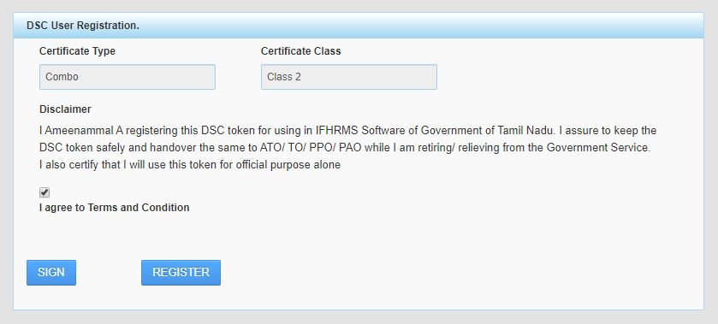
Registering DSC User in IFHRMS Application
3. Select “Disclaimer Terms & Condition”.

Slide 19
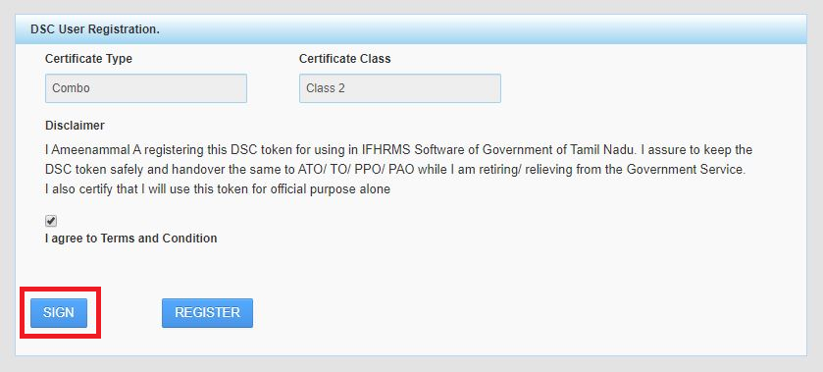
Registering DSC User in IFHRMS Application
3. Click “SIGN” button.

Slide 20
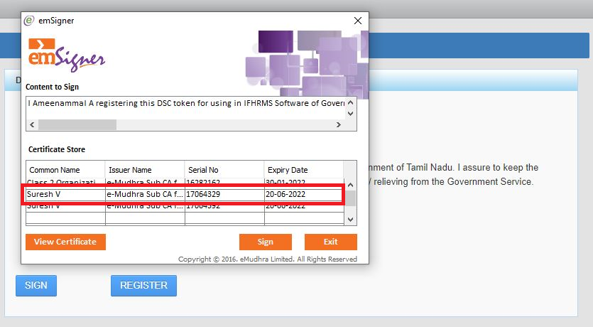
Registering DSC User in IFHRMS Application
5. Select Certificate and Click “View Certificate” button

Slide 21
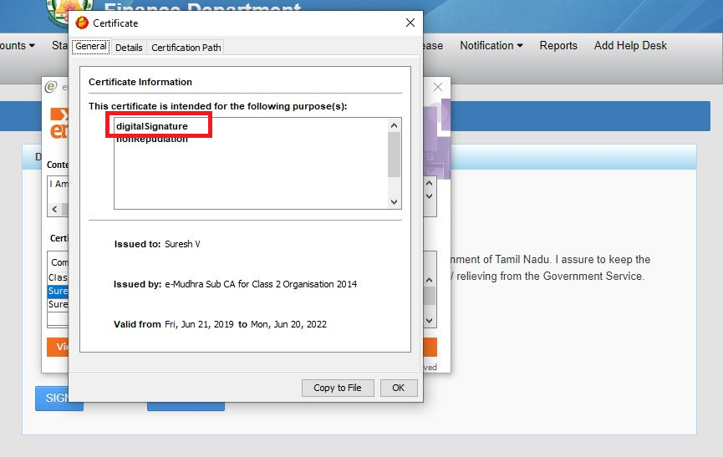
Registering DSC User in IFHRMS Application
6. Select Certificate with Certificate Information as “digitalSignature”

Slide 22
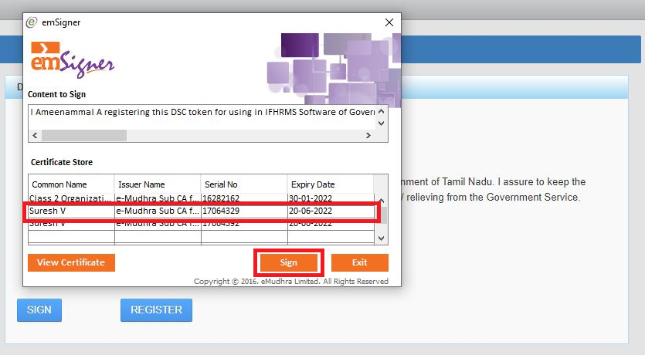
Registering DSC User in IFHRMS Application
7. Click “Sign” button in emSigner

Slide 23
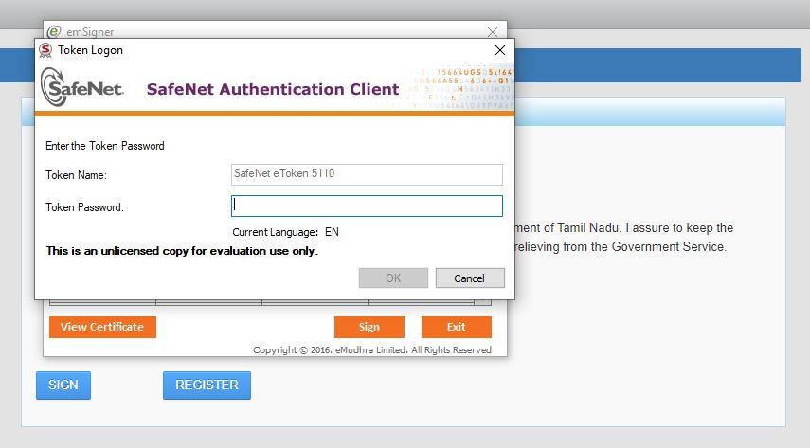
Registering DSC User in IFHRMS Application
8. Enter “Token Password” and click OK button.

Slide 24
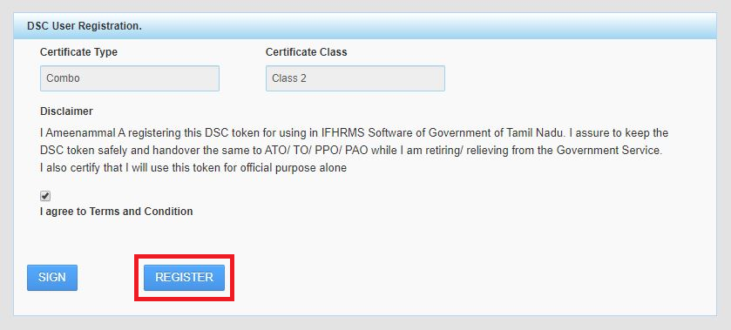
Registering DSC User in IFHRMS Application
9. Click “Register” to register user in IFHRMS Application.

Slide 25
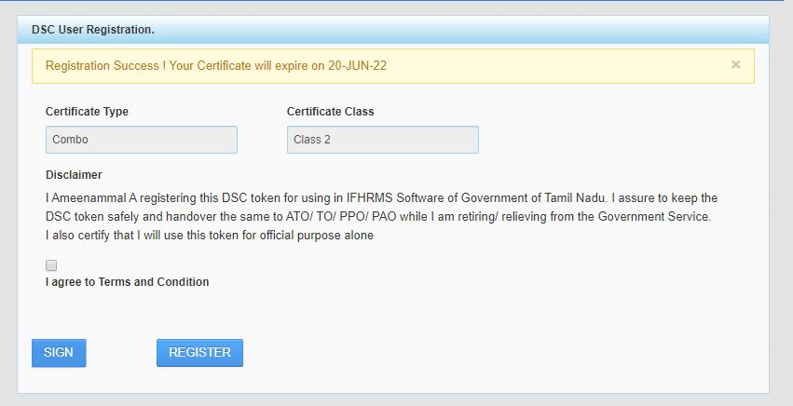
Registering DSC User in IFHRMS Application
Registration successful confirmation message

Slide 26
Bill Approving in IFHRMS Application using DSC
1. Click “Bill No.” from Notification window.

Slide 27
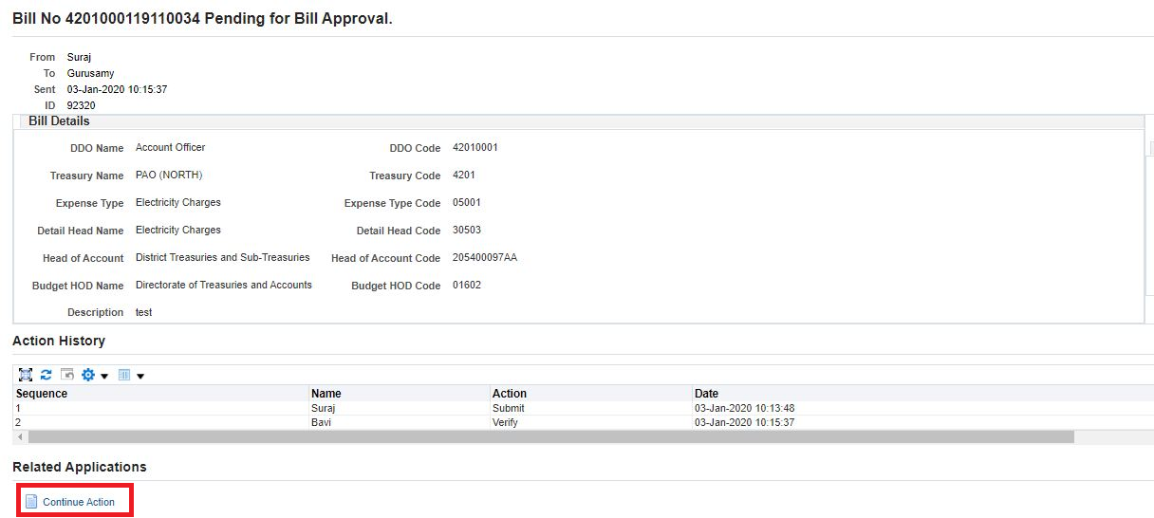
Bill Approving in IFHRMS Application using DSC
2. Click “Continue Action” from Bill Approval Page.

Slide 28
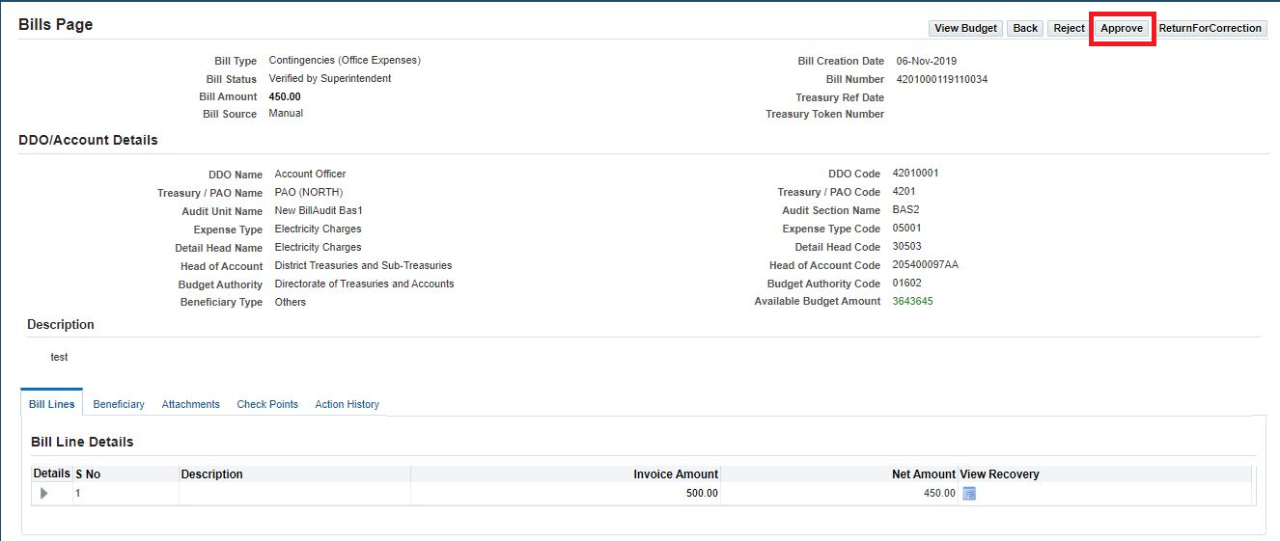
Bill Approving in IFHRMS Application using DSC
3. Click “Approve” from Bill Approve Page.

Slide 29
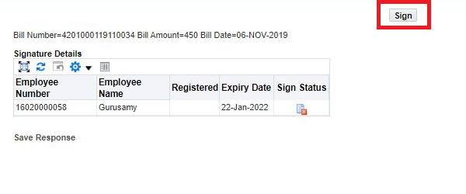
Bill Approving in IFHRMS Application using DSC
4. Click “Sign” from Bill Signing Page.

Slide 30
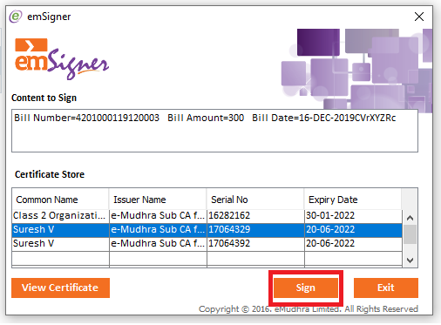
Bill Approving in IFHRMS Application using DSC
5. Select “digitalSignature Certificate” and Click “Sign” in emSigner.

Slide 31
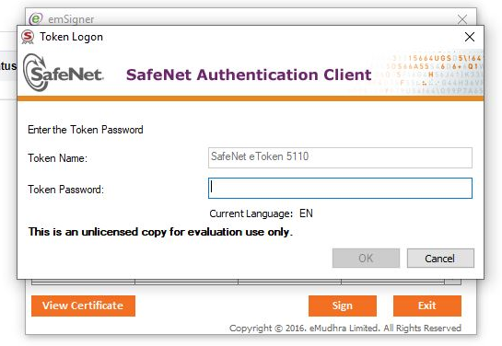
Bill Approving in IFHRMS Application using DSC
6. Enter “Token Password” and click “OK” in emSigner Logon screen.

Slide 32
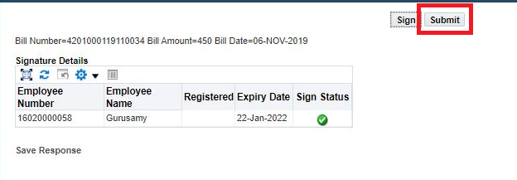
Bill Approving in IFHRMS Application using DSC
7. Click “Submit” from Bill Signing Page to approve bill using DSC.

Slide 33
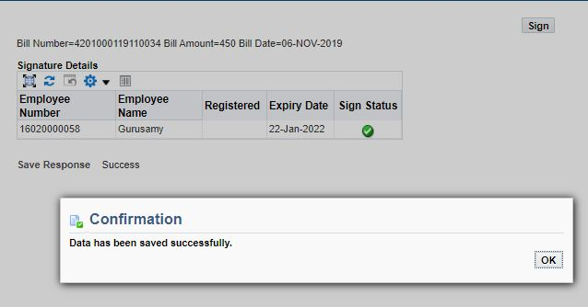
Bill Approving in IFHRMS Application using DSC
Approved Bill Confirmation.

